Slide 1
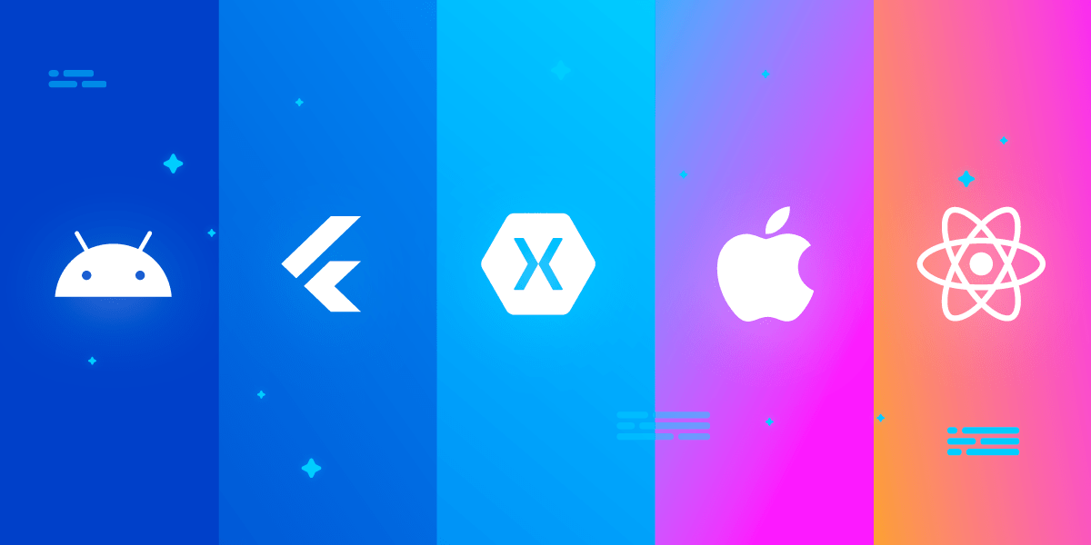

Flutter vs Other Cross-Platform Frameworks
A Comparative Analysis and Insights into Flutter's Ecosystem
Notes:
Hello everyone, welcome to our session on "Flutter v/s Other Cross-Platform Frameworks."In this Presentation we will delve into the world Flutter v/s Other Cross-Platform Frameworks.We will cover Cross-Platform Development, Comparative Analysis of Flutter and Other Frameworks, UI Capabilities and Exploring the Flutter Community.

Slide 2
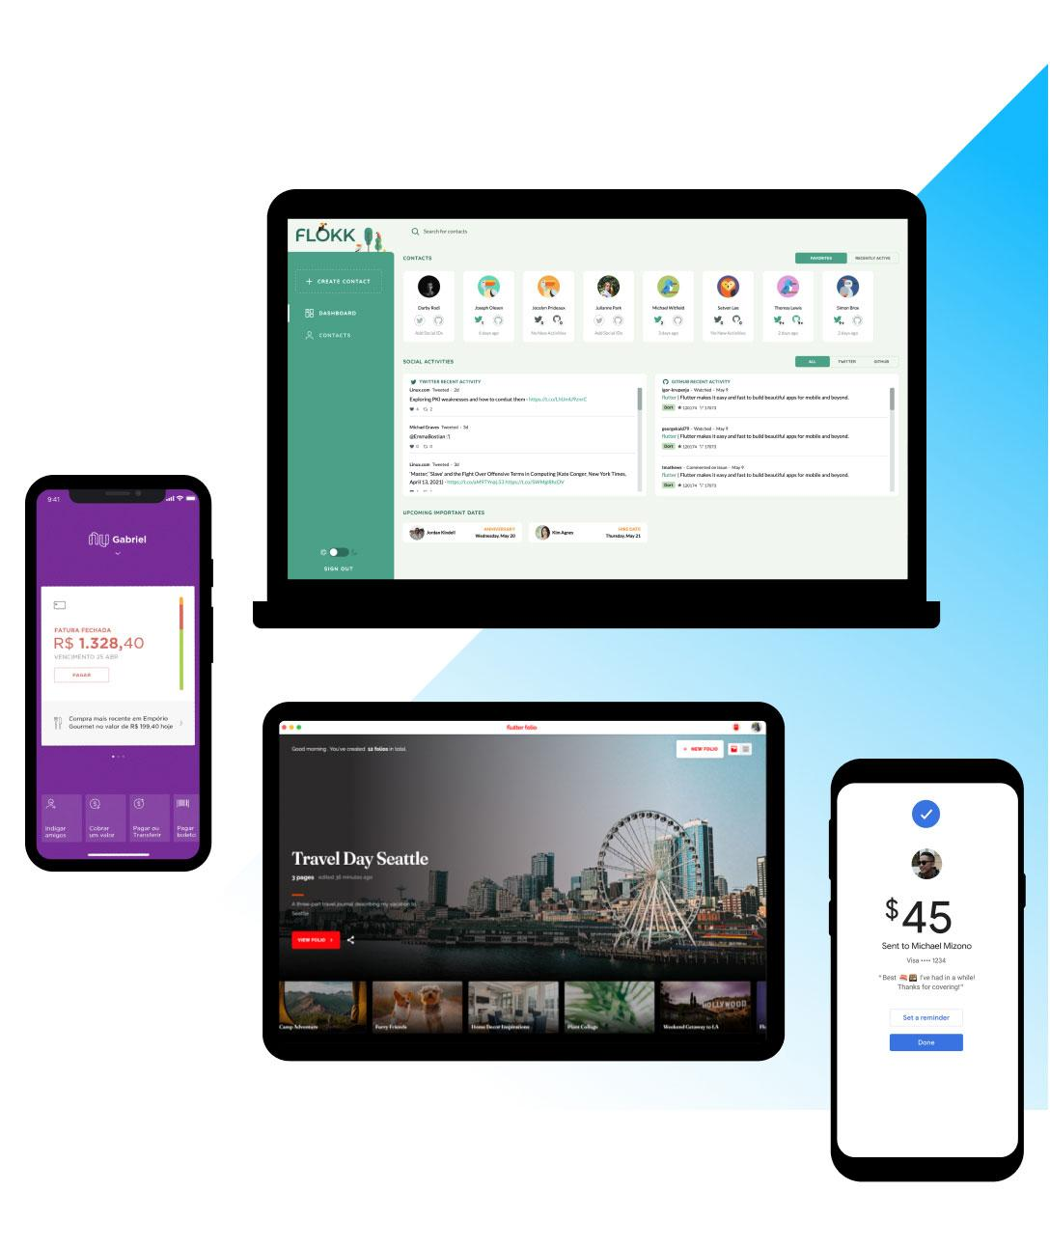
Introduction to Cross-Platform Development and Flutter
Flutter: A Modern Cross-Platform UI Toolkit
  Developed by Google
  Utilizes Dart, a modern and versatile programming language
  Declarative programming paradigm for building UIs
  Hot reload for instant feedback during development
  Streamlined development process
  Reduced development costs
  Consistent user experience across platforms
Notes:
Cross-Platform Development:
Imagine reaching users on both iOS and Android with a single codebase. That's the power of cross-platform development!
It streamlines development and reduces costs by building for multiple platforms efficiently.
Flutter: A Modern Cross-Platform UI Toolkit:
Enter Flutter, a game-changer from Google.
Built with the modern and versatile Dart language, Flutter empowers you to create smooth, native-looking apps for iOS, Android, web, and more.
Key Benefits of Flutter:
Declarative UI: Describe what you want, not how to build it, leading to cleaner and more maintainable code.
Hot Reload: See changes instantly reflected in the running app, accelerating development and iteration.
Streamlined Development: Flutter's rich widget library and tooling eliminate repetitive tasks, saving time and effort.
Reduced Costs: Reach more users with a single codebase, minimizing development and maintenance expenses.
Consistent UX: Deliver a familiar and polished experience across all supported platforms.

Slide 3
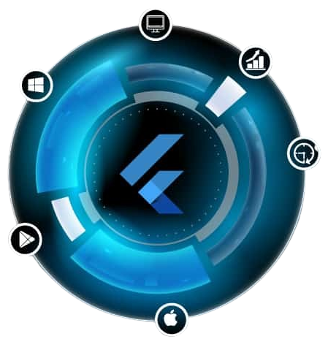
Comparative Analysis of Flutter and Other Frameworks
Performance
  Rendering speed and memory usage
  Network latency and device-specific optimizations
Development Experience
  Ease of use: Flutter's hot reload and declarative approach make it easier to learn and use
  Tooling support: Flutter has a very rich ecosystem of tools and plugins
Notes:
Performance:
Rendering speed and memory usage:
Flutter generally excels in smooth UI rendering on both Android and iOS thanks to its efficient Skia graphics engine.
However, some frameworks like React Native boast lower memory usage in specific circumstances.
Network latency and device-specific optimizations:
Both Flutter and other frameworks leverage platform-specific APIs for network requests.
Flutter optimizes rendering for different devices, but frameworks like Xamarin.Forms offer deeper access to native features for potential performance gains.
Development Experience:
Ease of use:
Flutter's hot reload, declarative approach, and rich widget library are praised for making development faster and more intuitive, especially for UI-intensive apps.
React Native requires more JavaScript knowledge and manual UI layout, while native frameworks like Swift or Kotlin can offer steeper learning curves.
Tooling support:
Flutter's ecosystem of tools and plugins, including DevTools and Codemagic, is vast and actively maintained.
This provides comprehensive support for development, debugging, and performance analysis.
Other frameworks have varying levels of tooling available, with React Native having a strong community-driven ecosystem.

Slide 4

UI Capabilities
Richness of UI Components
  wide range of built-in widgets and third-party packages
  Customizable UI components
Design Flexibility
  flexible UI customization
  Easy creation of complex and visually appealing UIs
Native-like Rendering
  native-like rendering
  ensures a consistent look and feel across platforms
  Seamless user experience
Notes:
Richness of UI Components:
Built-in widgets: Access a vast library of ready-to-use widgets covering core UI elements like buttons, text fields, and more.
Third-party packages: Expand your toolkit with countless community-created packages for specialized interactions, animations, and UI components.
Customizable UI:
Tailor widgets: Customize existing widgets through properties and adapt them to your specific design needs.
Build from scratch: Create truly unique UI elements using Flutter's low-level rendering APIs for ultimate flexibility.
Design Flexibility:
Go beyond limitations: Flutter is not restricted by platform-specific UI components, allowing you to unleash your creativity.
Complex layouts: Build intricate and dynamic layouts with ease, thanks to Flutter's flexible architecture and rich set of layout widgets.
Native-like Rendering:
Look and feel: Leverage Flutter's ability to render UI elements using native drawing APIs on each platform.
Consistency across devices: Your app will feel natural and familiar to users, regardless of whether they're on Android or iOS.
Seamless User Experience:
Effortless interaction: Build smooth and responsive animations and transitions that elevate the user experience.
Performance focus: Enjoy the benefits of Flutter's optimized rendering engine for silky-smooth interactions.

Slide 5

Exploring the Flutter Community
Open-source haven
Global reach
Diverse expertise
Unmatched support
Creative playground
Notes:
Open-source Haven:
Flutter embraces open-source development, fostering collaboration and transparency.
Contribute to core libraries, share your solutions, and learn from others' creations.
Global Reach:
Connect with fellow Flutter developers worldwide, regardless of location or time zone.
Participate in online forums, meetups, and conferences to exchange ideas and gain insights.
Diverse Expertise:
Leverage the collective knowledge of experienced developers, designers, and enthusiasts.
Find answers to your questions, solutions to your problems, and inspiration for your projects.
Unmatched Support:
Get help from fellow developers and official resources when you need it most.
Access comprehensive documentation, tutorials, and code samples to guide your learning and development.
Creative Playground:
Experiment with innovative ideas and push the boundaries of what's possible with Flutter.
Share your unique creations and inspire others to explore new possibilities.
Beyond these points:
The Flutter community is constantly evolving, offering new resources, events, and opportunities to engage and learn.
Joining this supportive and innovative community can accelerate your Flutter journey and empower you to build amazing things.

Slide 6

The Framework Showdown: Who Wins?
Flutter: The Champion of Cross-Platform Development
  Native Performance
  Expressive & Beautiful UIs
  Rapid Development & Hot Reload
  Single Codebase for All Platforms
  Large & Growing Community
Other Cross-Platform Frameworks
  Performance limitations compared to Flutter.
  Steeper learning curve for developers unfamiliar with the framework.
  Limited UI capabilities compared to Flutter's native rendering.
Notes:
While declaring an absolute winner in the "Framework Showdown" is subjective and depends on specific project needs, here's why Flutter is a strong contender and often considered a champion in cross-platform development:
1. Native Performance:
Flutter leverages Skia, a high-performance 2D graphics engine, delivering smooth and responsive UI across platforms.
While some frameworks prioritize web technologies, Flutter focuses on native-like rendering for a seamless user experience.
2. Expressive & Beautiful UIs:
Flutter's rich widget library and flexible architecture enable the creation of visually stunning and dynamic UIs that adapt to different screen sizes and resolutions.
Hot reload allows for rapid iteration and experimentation, empowering designers to bring their visions to life.
3. Rapid Development & Hot Reload:
Flutter's hot reload feature instantly reflects code changes in the running app, significantly speeding up development and enabling faster feedback loops.
This reduces development time and allows for a more experimental and iterative design process.
4. Single Codebase for All Platforms:
Write code once and deploy it to multiple platforms (Android, iOS, web, desktop) with minimal adjustments, significantly reducing development and maintenance costs.
This is a major advantage for teams focusing on building cross-platform apps in a resource-efficient manner.
5. Large & Growing Community:
Flutter enjoys a vibrant and supportive community of developers, designers, and enthusiasts worldwide.
This translates to abundant resources, tutorials, and assistance when needed, fostering collaboration and knowledge sharing.
It's important to be objective and avoid making sweeping generalizations when comparing frameworks. While Flutter has its strengths, other prominent cross-platform frameworks also offer distinct advantages and cater to different needs. Here's a nuanced look at some potential limitations mentioned:
1. Performance Limitations:
While Flutter generally excels in UI rendering performance, frameworks like React Native might achieve lower memory usage in specific scenarios.
It's crucial to benchmark and assess performance based on your specific app's needs and device targets.
2. Steeper Learning Curve:
Frameworks like Xamarin require knowledge of native languages (Swift/Kotlin), which can be a steeper learning curve for developers unfamiliar with those languages.
However, this approach can offer deeper native control and integration, potentially benefitting performance-critical apps.
3. Limited UI Capabilities:
Frameworks built on web technologies (e.g., React Native) may have limitations in achieving true native-looking UI elements compared to Flutter's direct rendering to native APIs.
However, these frameworks often benefit from vast web development communities and abundant UI component libraries

